Slide 1
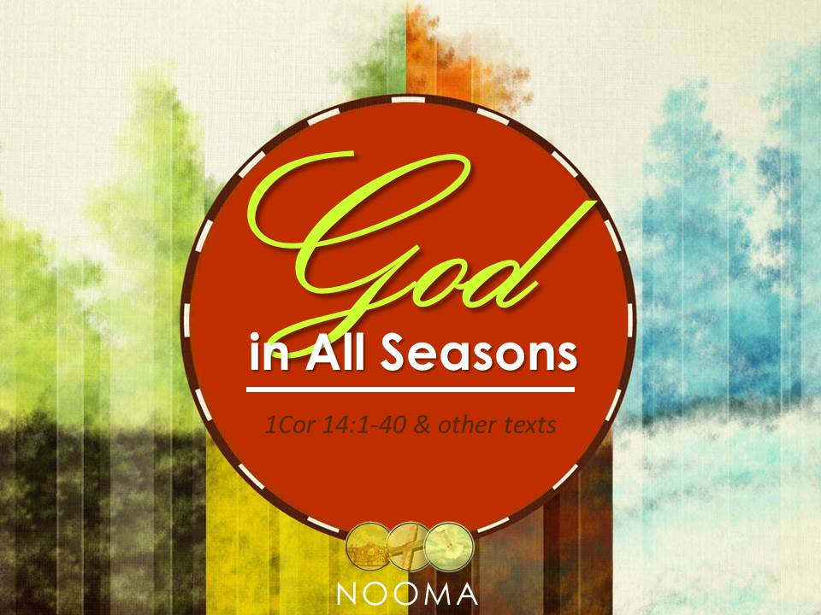

Slide 2
Notes:
Different seasons…
different clothing to be productive, comfortable, practical, effective
different activities or work
different weather conditions (each season is unique, although regional)
different joys

Slide 3
The Spirit, in His PERSON, never changes.
The Spirit, in His WORK, sometimes changes His methods to fit the situation.
The Spirit, can CHANGE whatever He wants and always does so as an IMPROVEMENT (1Cor 12:11, 18; 14:5, 12, 24-25).

Slide 4
Cessationism is the belief that the giving of certain of the Spiritual gifts has ceased
  Specifically, the miraculous sign gifts have ceased
    e.g. healing, exorcism, miracles, speaking in tongues, interpretation, prophecy, discernment of Spirits
  These special gifts were active during the infancy of the church, described in the narrative of Acts, and practiced by the apostles
Notes:
http://www.metropolitantabernacle.org/Sword-And-Trowel/Evangelical-Magazine-Sword-and-Trowel-Articles/Cessationism-Proving-Charismatic-Gifts-have-Ceased
“The term cessationism comes from the great 17th-century confessions of faith, such as the Westminster and Baptist confessions. ”

Slide 5
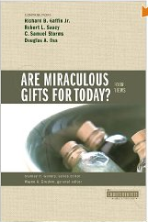
Cessationist
Open, but cautious
Third wave – expectant evangelicals
Pentecostal/charismatic
v
Categories are borrowed from Wayne Grudem,
“Are Miraculous Gifts for Today?: 4 Views”
Notes:
Cessationist = none or no sign gifts
Open, but cautious = sign gifts may be given still today, but there is a real danger towards abuse
Expectant evangelicals = looking for miracles to happen, gifting to happen again
Pentecostal/charismatic = all sign gifts are active, regular part of Christian faith, no gaps have ever happened
http://www.gotquestions.org/cessationism.html -- S. Michael Houdmann
The Apostle Paul predicted that the gift of tongues would cease (1 Corinthians 13:8). Here are six proofs that it has already ceased:
1) The apostles, through whom tongues came, were unique in the history of the church. Once their ministry was accomplished, the need for authenticating signs ceased to exist.
2) The miracle (or sign) gifts are only mentioned in the earliest epistles, such as 1 Corinthians. Later books, such as Ephesians and Romans, contain detailed passages on the gifts of the Spirit, but the miracle gifts are not mentioned, although Romans does mention the gift of prophecy. The Greek word translated “prophecy” means “speaking forth” and does not necessarily include prediction of the future.
3) The gift of tongues was a sign to unbelieving Israel that God’s salvation was now available to other nations. See1 Corinthians 14:21-22andIsaiah 28:11-12.
4) Tongues was an inferior gift to prophecy (preaching). Preaching the Word of God edifies believers, whereas tongues does not. Believers are told to seek prophesying over speaking in tongues (1 Corinthians 14:1-3).
5) History indicates that tongues did cease. Tongues are not mentioned at all by the Post-Apostolic Fathers. Other writers such as Justin Martyr, Origen, Chrysostom, and Augustine considered tongues something that happened only in the earliest days of the Church.
6) Current observation confirms that the miracle of tongues has ceased. If the gift were still available today, there would be no need for missionaries to attend language school. Missionaries would be able to travel to any country and speak any language fluently, just as the apostles were able to speak in Acts 2. As for the miracle gift of healing, we see in Scripture that healing was associated with the ministry of Jesus and the apostles (Luke 9:1-2). And we see that as the era of the apostles drew to a close, healing, like tongues, became less frequent. The Apostle Paul, who raised Eutychus from the dead (Acts 20:9-12), did not heal Epaphroditus (Philippians 2:25-27), Trophimus (2 Timothy 4:20), Timothy (1 Timothy 5:23), or even himself (2 Corinthians 12:7-9). The reasons for Paul’s “failures to heal” are 1) the gift was never intended to make every Christian well, but to authenticate apostleship; and 2) the authority of the apostles had been sufficiently proved, making further miracles unnecessary.
The reasons stated above are evidence for cessationism. According to1 Corinthians 13:13-14:1, we would do well to “pursue love,” the greatest gift of all. If we are to desire gifts, we should desire to speak forth the Word of God, that all may be edified.
Read more:http://www.gotquestions.org/cessationism.html#ixzz2gsxvNs91

Slide 6
Scope
Cessationist
  Concentric → ceased generally, still functioning in unreached pockets, to spread gospel
  Classical → sign gifts finish with the close of the canon, God still at work miraculously, no new rev
  Full → no miraculous gifts, no miracles today
  Consistent → miraculous gifts were for early church only, all Eph 4 offices are also finished
Categories are borrowed from www.monergism.com
Notes:
http://www.monergism.com/directory/link_category/Spiritual-Gifts/Cessationists-View-Articles/
Cessationists are divided into four main groups:
Concentric Cessationists believe that the miraculous gifts have indeed ceased in the mainstream church and evangelized areas, but appear in unreached areas as an aid to spreading the Gospel (Luther and Calvin, though they were somewhat inconsistent in this position).
Classical cessationists assert that the "sign gifts" such as prophecy, healing and speaking in tongues ceased with the apostles and the finishing of the canon of Scripture. They only served as launching pads for the spreading of the Gospel; as affirmations of God's revelation. However, these cessationists do believe that God still occasionally does miracles today, such as healings or divine guidance, so long as these "miracles" do not accredit new doctrine or add to the New Testament canon. Richard Gaffin, John F. MacArthur and Daniel B. Wallace are perhaps the best-known classical cessationists.
Full Cessationists argue that along with no miraculous gifts, there are also no miracles performed by God today. This argument, of course, turns on one's understanding of the term, "miracle." B. B. Warfield, J. Gresham Machen, F.N. Lee.
Consistent Cessationists believe that not only were the miraculous gifts only for the establishment of the first-century church, but the so-called fivefold ministry found in Eph. 4 was also a transitional institution (i.e., There are no more apostles or prophets, but also no more pastors, teachers, or evangelists).

Slide 7
The OT filling of the Spirit seems to be more task specific, temporary (Jud 3:10, 14:6, 19)
There are periods where God seems silent or inactive (1 Sam 3:1; Jud 6:13)
God has limited Himself at various times to communicate with us (e.g. incarnation, Php 2:7)
Notes:
Miracles occurred in four major seasons in Scriptures: The Exodus (and conquest), the lives/ministries of Elijah and Elisha (1 Kgs), Christ’s ministry (gospels), the birth of the church (Acts).

Slide 8
The giving and practice of SOME of the Spiritual gifts have ceased –no longer needed
The early church needed these gifts as validation for their new IDENTITY (Heb 2:3-4)
The need for revelatory gifts faded with the completion of the SCRIPTURES
The Scriptures talk about the ceasing of MIRACULOUS gifts (1 Cor 13:8-10)

Slide 9
“Miracles occurred in the New Testament era to validate the new message the apostles’ preached. With the completion of the canon of Scripture the need for miracles as a validating sign disappeared; the authority of the
Word of God was sufficient to validate the messenger’s word.”
-- Paul Enns

Slide 10
We do not believe that miracles, healing, Spiritual gifts or the Spirit’s work in the world have CEASED
We do not believe that EXPERIENTIAL data holds greater weight than Scripture
We do not believe that the miraculous gifts are intended to GLORIFY the miracle-worker or endorse his spirituality (1Cor 14:18-19; 14:1; 12:29-31)

Slide 11
“…We also believe that the Holy Spirit provides believers with service gifts for the equipping of the saints and to build up the body of Christ. He also gave temporary sign gifts to the early church (prophesying the future, speaking in tongues, interpretation of tongues, miracles and healing) that have ceased.”

Slide 12
“With these spiritual gifts God made provision for the nurturing of the church in its infancy. Before the completion of the Scriptures, before the dissemination of the knowledge of the doctrines of the Scripture, God gave men sign gifts. These gifts were exercised to those without the church, so that unbelievers might come to trust the man who came with a message from God.”
-- Dwight Pentecost

Slide 13
God can and will use whatever MEANS that He deems necessary to rescue the souls of men and bring glory to Himself.
  The purposes of God have not wavered
  The methods or techniques have adjusted to fit the season, the people, or the situation

Slide 14
“As much as anything, I am for the truth expressed in John 3, the truth that in his activity the Spirit is like the blowing wind, sovereign and ultimately incalculable. Any sound theology of the Holy Spirit, I take it, will be left with a certain remainder, a surplus unaccounted for, an area of mystery.”
-- Richard Gaffin, Jr.
Notes:
Dr. Wayne Grudem: “I am thankful for that. However, Tim, I think we have to recognize that there is a segment of the cessationist community that is ready to pounce on anyone who speaks of subjective forms of guidance; ready to pounce on anyone who speaks of dealing with promptings of the Lord in one way or another; that is highly suspicious of any emotional component in worship or prayer. I don’t know that that is representative of all of cessationism but there is a segment of the cessationist community that is so suspicious of any emotional component, any subjective component in all of our relationship with God and with others that it tends to quench a vital aspect of the personal relationship with God in the lives of ordinary believers. And that can tend to a dry orthodoxy in the next generation that abandons that faith and the church spiritually becomes dry and static, and I’m concerned about that.”

